Slide 1
UNICORE in XSEDE:
The Journey Down the Road Less Traveled By
UNICORE Summit
30 May 2012

Slide 2
Presentation Overview
XSEDE
  Overview
  Partners
  Cyberinfrastructure
  Architecture
  Software and UNICORE
  Software Engineering
UNICORE Deployments in XSEDE
Campus Bridging
Q&A

Slide 3
The Road Not Taken
Robert Frost, The Road Not Taken. 1920. Mountain Interval.
Two roads diverged in a yellow wood,
And sorry I could not travel both,
And be one traveler, long I stood
And looked down one as far as I could (Globus?)
To where it bent in the undergrowth;
Then took the other, as just as fair, (UNICORE?)
And having perhaps the better claim, …

Slide 4
XSEDE Overview

Slide 5
What is XSEDE?
XSEDE is The eXtreme Science and Engineering Discovery Environment

Slide 6
What is XSEDE?
XSEDE: The Successor to the TeraGrid
XSEDE is a comprehensive, professionally managed set of advanced heterogeneous high-end digital services for science and engineering research integrated into a general-purpose cyberinfrastructure
XSEDE is distributed but architecturally and functionally integrated

Slide 7
XSEDE Vision
XSEDE:
  enhances the productivity of scientists and engineers by providing them with new and innovative capabilities
and thus
  facilitates scientific discovery while enabling transformational science/engineering and innovative educational programs
Notes:
Providing capabilities and services beyond flops
We provide the integrated environment allowing for the coherent use of the various resources and services supported by NSF.

Slide 8
Science Requires Diverse Digital Capabilities
XSEDE is about increased user productivity
  increased productivity leads to more science
  increased productivity is sometimes the difference between a feasible project and an impractical one
Notes:
Integrating services for TEOS, AUSS, CMS, and TIS

Slide 9
Heroic Effort Not Required, hopefully…
Working towards “easy-to-use” general-purpose cyberinfrastructure
  Easy-to-use is relative
  There is no HPC “easy button”
Notes:
Integrating services for TEOS, AUSS, CMS, and TIS

Slide 10
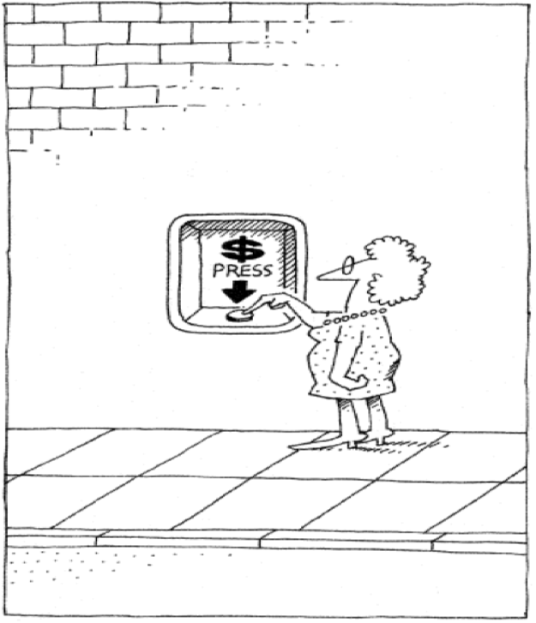
Simple Enough

Slide 11
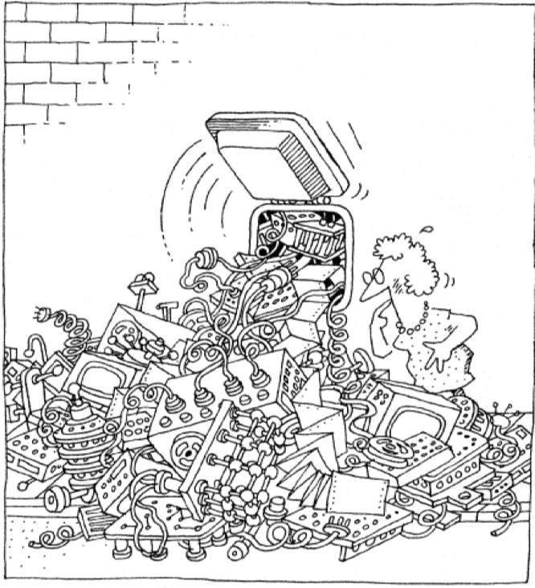
OOPS

Slide 12
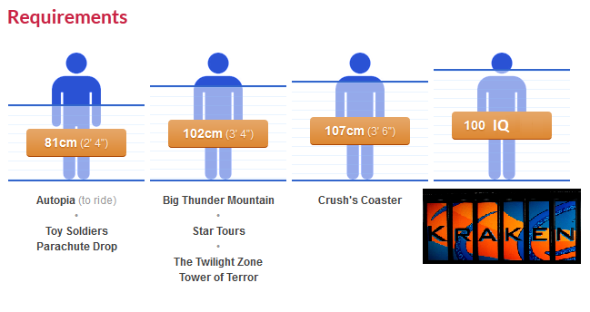
Heroic Effort Not Required, hopefully…
  “Must be this tall to ride this ride”
Notes:
Integrating services for TEOS, AUSS, CMS, and TIS

Slide 13
Where are we at 8 months into project
XSEDE is organized…

Slide 14
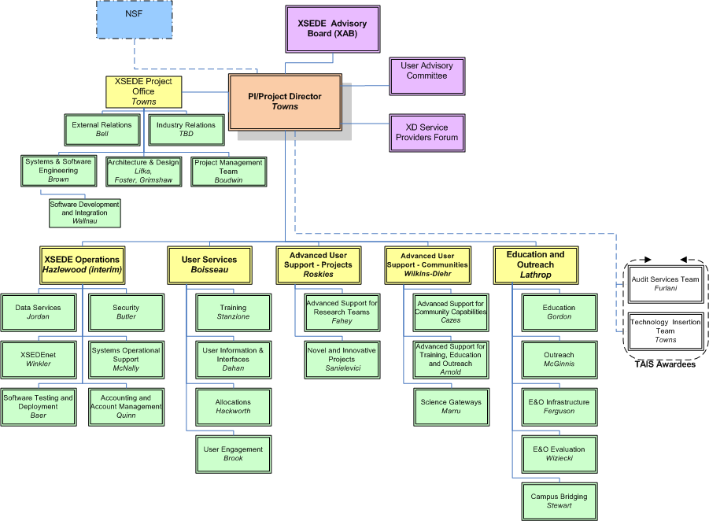
XSEDE Org Chart

Slide 15
Where are we at 8 months into project
Software and Services of TeraGrid transitioned
Created Set of Baseline documents defined
  https://www.xsede.org/web/guest/project-documents
  Service Provider definition documents
  Architecture documents
  Software Engineering Requirements
  Software and Services Baseline
  Technical Security Baseline
Software Going through Engineering Process

Slide 16
XSEDE Partners

Slide 17
XSEDE Partnership
XSEDE is led by the University of Illinois’ National Center for Supercomputing Applications
The partnership includes the following institutions and organizations . . .

Slide 18




Slide 19
XSEDE Partners
Center for Advanced Computing
Cornell University
Indiana University
Jülich Supercomputing Centre
National Center for Atmospheric Research
National Center for Supercomputing Applications
University of Illinois at Urbana-Champaign
National Institute for Computational Sciences
University of Tennessee Knoxville
Ohio Supercomputer Center
The Ohio State University

Slide 20
XSEDE Partners
Open Science Grid (OSG)
Partnership for Advanced Computing in Europe (PRACE)
Pittsburgh Supercomputing Center
Carnegie Mellon University/University of Pittsburgh
Purdue University
Rice University
San Diego Supercomputing Center
University of California San Diego
Shodor Education Foundation
Southeastern Universities Research Association

Slide 21
XSEDE Partners
Texas Advanced Computing Center
University of Texas at Austin
University of California Berkeley
University of Chicago
University of Virginia

Slide 22
XSEDE Cyberinfrastructure

Slide 23
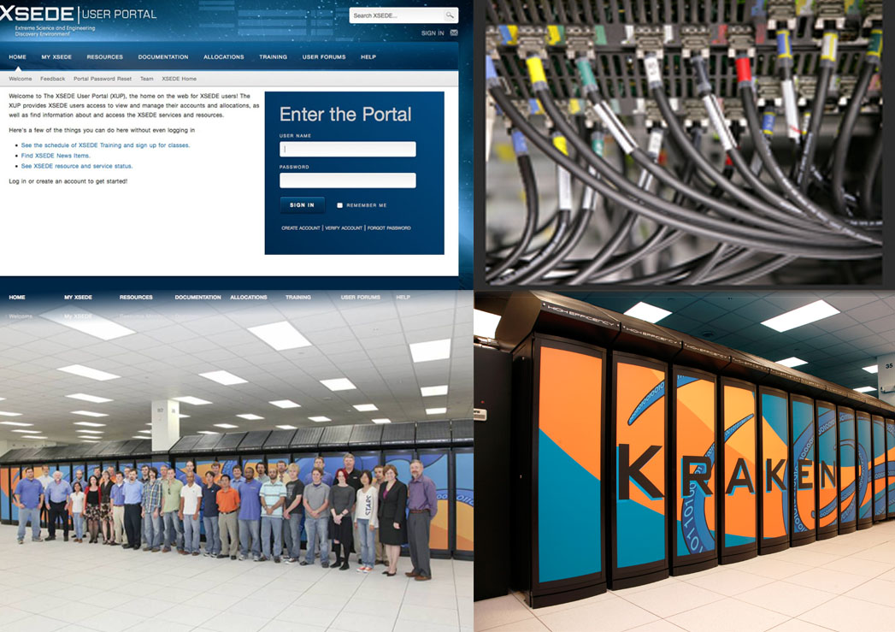

Slide 24
Cyberinfrastructure
The XSEDE cyberinfrastructure (CI) comprises data processing, computing, data storage and networking capabilities, and a range of associated services independently funded by a variety of NSF and other programs. This CI is augmented and enhanced by facilities and services from campus, regional and commercial providers.
Thus, XSEDE national CI is powered by a broad set of Service Providers (SP)

Slide 25
Network Resources
XSEDEnet – XSEDE private network (10Gbps)
Institution network connection
Usually to a regional network provider connected to Internet2 or NLR (10Gbps)

Slide 26
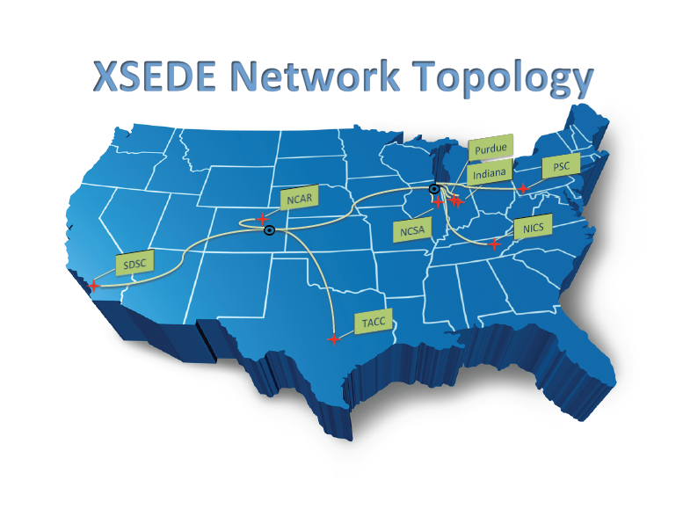









Slide 27
Current XSEDE Compute Resources
Kraken @ NICS
  1.2 PF Cray XT5
Ranger @ TACC
  580 TF Sun Cluster
Gordon @ SDSC
  341 TF Appro Distributed SMP cluster
Lonestar (4) @ TACC
  302 TF Dell Cluster
Forge @ NCSA
  150 TF Dell/NVIDIA GPU Cluster
Trestles @ SDSC
  100TF Appro Cluster
Steele @ Purdue
  67 TF Dell Cluster
Blacklight @ PSC
  36 TF SGI UV (2 x 16TB shared memory SMP)
https://www.xsede.org/web/xup/resource-monitor

Slide 28
Current XSEDE Visualization and Data Resources
Storage
  Albedo
    1 PB Lustre distributed WAN filesystem
  Data Capacitor @ Indiana
    535 TB Lustre WAN filesystem
  Data Replication Service
    1PB iRODS distributed storage
  HPSS @ NICS
    6.2 PB tape
  MSS @ NCSA
    10 PB tape
  Golem @ PSC
    12 PB tape
  Ranch @ TACC
    70 PB tape
  HPSS @ SDSC
    25 PB tape
Visualization
  Nautilus @ UTK
    8.2 TF SGI/NVIDIA SMP
    960 TB disk
  Longhorn @ TACC
    20.7 TF Dell/NVIDIA cluster
    18.7 TB disk
  Spur @ TACC
    1.1 TF Sun cluster
    1.7 PB disk
https://www.xsede.org/web/xup/
resource-monitor#advanced_vis_systems
https://www.xsede.org/web/xup/
resource-monitor#storage_systems

Slide 29
Current XSEDE Special Purpose Resources
Condor Pool @ Purdue
  150 TF, 27k cores
Keeneland @ GaTech/NICS
  developmental GPU cluster platform
  production GPU cluster expected in July 2012
FutureGrid
  Experimental/development distributed grid environment
https://www.xsede.org/web/xup/resource-monitor#special_purpose_systems

Slide 30
XSEDE Cyberinfrastructure Integration
Open Science Grid
PRACE

Slide 31
OSG Relationship
OSG is a Service Provider in XSEDE
  anticipated to be a Level 1 SP
OSG resources are made available via XSEDE allocations processes
  primarily HTC resources
  opportunistic nature of OSG resource presented a new twist to allocations processes and review
OSG has two other interaction points with XSEDE
  participation in outreach/campus bridging/campus champions activities
    assure incorporation of the OSG cyberinfrastructure resources and services into campus research and education endeavors
  effort in ECSS specifically to work with applications making use of both OSG and XSEDE resources

Slide 32
XSEDE and PRACE
Long standing relationship with DEISA
  DEISA now subsumed into PRACE
Ongoing series of Summer Schools
  next one in Dublin, Ireland, June 24-28
  www.xsede.org/web/summerschool12
  Application deadline in March 18!!!

Slide 33
Developing longer term XSEDE/PRACE plans
Joint allocations call by late CY2012
  support for collaborating teams
  make one request for XSEDE and PRACE resources
  call for Expressions of Interest (EoI) in the next couple of months
Interoperability/collaboration support
  driven by identified needs of collaborating teams in US and Europe
  beginning with technical exchanges to develop deeper understanding on one another's architectures and environments
    involving other relevant CIs: OSG, EGI, NGI,…
    first meeting in conjunction with Open Grid Forum on March 16 in Oxford, UK

Slide 34
XSEDE Architecture

Slide 35
Planning for XSEDE
In 2010, NCSA awarded one of two planning grants as a top finalist for NSF XD cyberinfrastructure solicitation
Competitors were from two roads:
  Globus – XROADS: UCSD, UChicago, etc.
  UNICORE – XSEDE: NCSA, NICS, PSC, TACC

Slide 36
Planning for XSEDE
XSEDE won and
“…took the road less travelled by
and that has made all the difference”
…But wait, Reviewers advised NSF to combine some aspects of XROADS into XSEDE
So to reduce risk we are going down both roads

Slide 37
High Level View of the XSEDE Distributed Systems Architecture
Access Layer:
  provides user-oriented interfaces to services
  APIs, CLIs, filesystems, GUIs
Services Layer:
  protocols that XSEDE users can use to invoke service layer functions
  execution management, discovery, information services, identity, accounting, allocation, data management,…
  quite literally, the core of the architecture
Resources Layer:
  compute servers, filesystems, databases, instruments, networks, etc.
APIs
and CLIs
Transparent access via the file system
Thin and Thick
Client GUIs
Access Layer
Services Layer
Identity
Execution Mgt
Discovery & Info
Accounting & Alloc
Data Management
Infrastructure Svcs
…
…
…
Resources

Slide 38
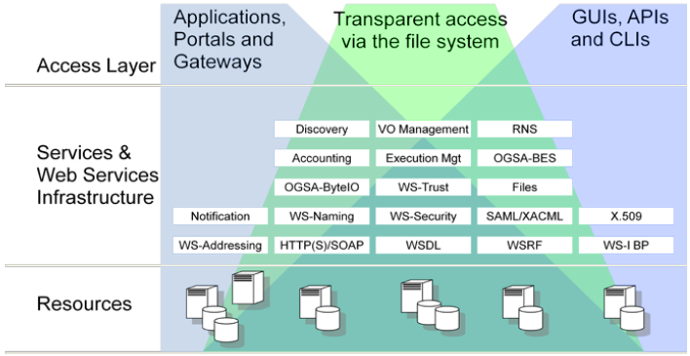
XSEDE Architecture

Slide 39
Access Layer
Thin client GUIs
  accessed via a web browser
  Examples: XSEDE User Portal, Globus Online, many gateways
Thick client GUIs
  require some application beyond a Web browser
  Examples: Genesis II GUI and the UNICORE 6 Rich Client (URC)
Command line interfaces (CLIs)
  tools that that allow XSEDE resources and services to be accessed from the command line or via scripting languages
  Examples: UNICORE Command Line Client (UCC), the Globus Toolkit CLI, the Globus Online CLI, and the Genesis II grid shell
    typically implemented by programs that must be installed
Application programming interfaces (APIs)
  language-specific interfaces to XSEDE services
  implemented by libraries
  Examples: Simple API for Grid Applications (SAGA) bindings, Genesis II Java bindings, jGlobus libraries
File system mechanisms:
  file system paradigm and interfaces
  Examples (beyond local file systems): XSEDE Wide File System (XWFS), Global Federated File System (GFFS)

Slide 40
Services Layer
Execution Management Services (BES, etc.)
  instantiating/managing units of work
    single activities, sets of independent activities, or workflows
Discovery and Information Services
  find resources based on descriptive meta data
  subscribe to events or changes in resource status
Identity
  identify and provide attributes about individuals, services, groups, roles, communities, and resources
Accounting and Allocation
  keeping track of resource consumption, and what consumption is allowed
Infrastructure Services
  naming and binding services, resource introspection and reflection services, and fault detection and recovery services
Help Desk and Ticketing
  interfaces for ticket management and help desk federation

Slide 41
What does this mean?
Architectural design drives processes to produce useful capabilities for XSEDE users
Some new capabilities currently in process that fit into the XSEDE architecture:
  UNICORE
  Globus Online
    reliable, high-performance file transfer
    …as a service
  Genesis II/Global Federated File System (GFFS)
    data sharing
    UNICORE
    resource sharing

Slide 42
XSEDE Software

Slide 43
Summary of UNICORE Software in XSEDE
* - In beta, pre-production deployment
Capability | SP Level 1 |  |  | SP Level 2 |  |  | SP Level 3/ Campus Bridging
 | SP Type |  |  | SP Type |  |  | SP Type
 | HPC | HTC | Viz | HPC | HTC | Viz | HPC | HTC | Viz
Remote Compute*
UNICORE 6.4.2/6.4.2-p2 | Yes | Yes | Yes | Yes | Yes | Yes | No³ | No³ | No³
GUI*
UNICORE Rich Client (URC) | Yes | Yes | Yes | Yes | Yes | Yes | No³ | No³ | No³
CLI*
UCC | Yes | Yes | Yes | Yes | Yes | Yes | No³ | No³ | No³

Slide 44
XSEDE Software and Services
Capability | SP Level 1 |  |  | SP Level 2 |  |  | SP Level 3/ Campus Bridging
 | SP Type |  |  | SP Type |  |  | SP Type
 | HPC | HTC | Viz | HPC | HTC | Viz | HPC | HTC | Viz
Registration
pacman | Yes | Yes | Yes | Yes | Yes | Yes | Yes | Yes | Yes
Globus-mds-info | Yes | Yes | Yes | Yes | Yes | Yes | Yes | Yes | Yes
ctss-core-registration | Yes | Yes | Yes | Yes | Yes | Yes | Yes | Yes | Yes
Verification/Validation
INCA | Yes | Yes | Yes | Yes | Yes | Yes | No³ | No³ | No³
Accounting and Acct Mgmt
AMIE – Account Mgmt Info Exchange | Yes | Yes | Yes | Yes | Yes | Yes | No³ | No³ | No³
Data Movement Servers
ctss-data-mvmt-servers-registration | Yes | Yes | Yes | Yes | Yes | Yes | No³ | No³ | No³
GridFTP | Yes | Yes | Yes | Yes | Yes | Yes | No³ | No³ | No³
GSI OpenSSH with HPN (server) | Yes | Yes | Yes | Yes | Yes | Yes | No³ | No³ | No³
Data Movement Clients
ctss-data-mvmt-clients-registration | Yes | Yes | Yes | Yes | Yes | Yes | No³ | No³ | No³
globus-url-copy | Yes | Yes | Yes | Yes | Yes | Yes | No³ | No³ | No³
GSI OpenSSH with HPN (client) | Yes | Yes | Yes | Yes | Yes | Yes | No³ | No³ | No³
UberFTP | Yes | No³ | No³ | Yes | No³ | No³ | No³ | No³ | No³

Slide 45
XSEDE Software and Services
Capability | SP Level 1 |  |  | SP Level 2 |  |  | SP Level 3/ Campus Bridging
 | SP Type |  |  | SP Type |  |  | SP Type
 | HPC | HTC | Viz | HPC | HTC | Viz | HPC | HTC | Viz
Local Compute
ctss-local-compute-registration | Yes | No³ | No³ | Yes | No³ | No³ | No³ | No³ | No³
globus-wsrf | Yes | No³ | No³ | Yes | No³ | No³ | No³ | No³ | No³
XSEDE GLUE2 publishing | Yes | No³ | No³ | Yes | No³ | No³ | No³ | No³ | No³
Local resource management system (Load Leveler, PBS, Torque, SGE, etc) | Yes | No³ | No³ | Yes | No³ | No³ | No³ | No³ | No³
Remote Compute
ctss-remote-compute-registration | Yes | Yes | Yes | Yes | Yes | Yes | No³ | No³ | No³
GRAM5 | Yes | Yes | Yes | Yes | Yes | Yes | No³ | No³ | No³
UNICORE 6.4.2 | Yes | Yes | Yes | Yes | Yes | Yes | No³ | No³ | No³

Slide 46
XSEDE Software and Services
Capability | SP Level 1 |  |  | SP Level 2 |  |  | SP Level 3/ Campus Bridging
 | SP Type |  |  | SP Type |  |  | SP Type
 | HPC | HTC | Viz | HPC | HTC | Viz | HPC | HTC | Viz
Single Sign-On / Remote Login
ctss-login-registration | Yes | Yes | Yes | Yes² | Yes² | Yes² | No³ | No³ | No³
GSI OpenSSH with HPN | Yes | Yes | Yes | Yes² | Yes² | Yes² | No³ | No³ | No³
gx-map | Yes | Yes | Yes | Yes² | Yes² | Yes² | No³ | No³ | No³
myproxy client | Yes | Yes | Yes | Yes² | Yes² | Yes² | No³ | No³ | No³
tgusage | Yes | Yes | Yes | Yes² | Yes² | Yes² | No³ | No³ | No³
modules | Yes | No³ | No³ | Yes² | Yes² | Yes² | No³ | No³ | No³
tgproxy | Yes | Yes | Yes | Yes² | Yes² | Yes² | No³ | No³ | No³
Common User Environment “CUE” | Yes | No³ | Yes | Yes² | Yes² | Yes² | No³ | No³ | No³
GUI
UNICORE Rich Client (URC) | Yes | No³ | No³ | Yes² | No³ | No³ | No³ | No³ | No³
Visualization SW Support
vtss-registration | No³ | No³ | Yes | No³ | No³ | Yes | No³ | No³ | No³

Slide 47
XSEDE Software Engineering

Slide 48
XSEDE Engineering Process: High Level
System & Software Engineering
Requirements
Architecture and Design
Constraints
Architecture
XSEDE Engineering Processes
Software Development and Integration
Enterprise
“Software”
Service Provider
“Software &
Services”
XSEDE Engineering Processes
Operations
Campus Bridging

Slide 49
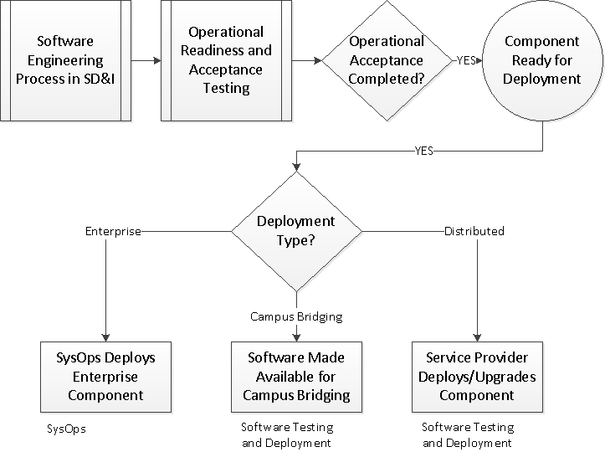
Software and Service Deployment

Slide 50
UNICORE Deployments in XSEDE

Slide 51
Planned UNICORE 6.4.2 Deployments
Beta Deployment soon of UNICORE/Genesis II on four XSEDE systems at NCSA, NICS, PSC and TACC
Deployment of SDIACT-097, which is UNICORE 6.4.2-p2, sometime next year (July 2012)

Slide 52
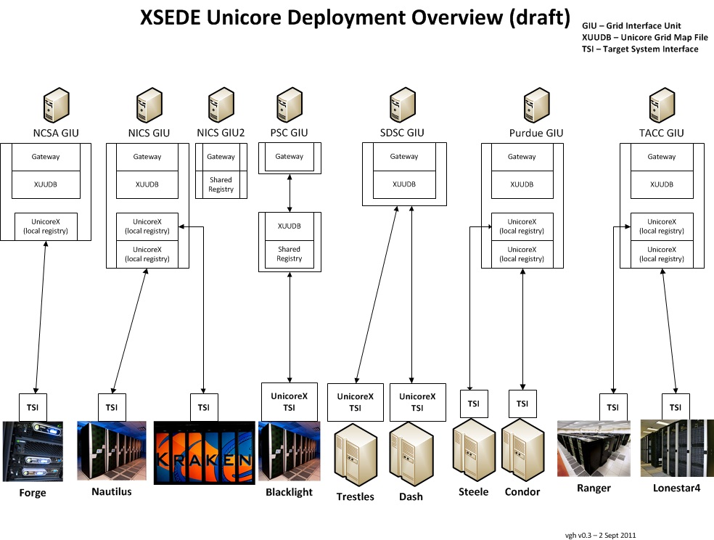

Slide 53
XSEDE Campus Bridging

Slide 54
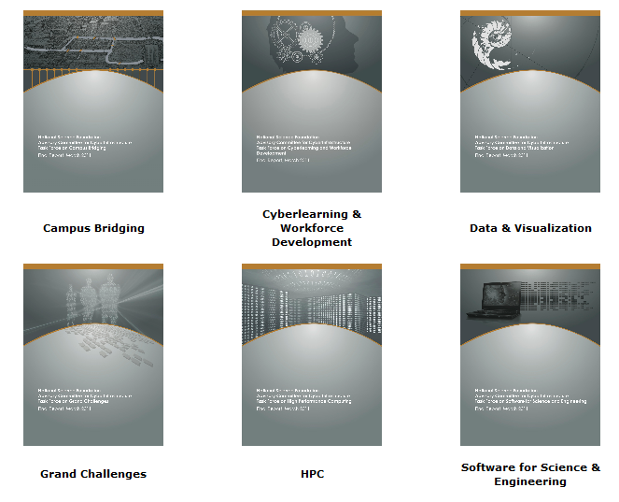
NSF
Advisory Committee for Cyberinfrastucture
Task Forces

Slide 55
Campus Bridging Task Force Findings
The CI environment in the US is now much more complex and varied due to the maturity of commercial cloud facilities, volunteer computing, and rapid development of CI
The science and engineering research community is not using the existing CI as effectively or efficiently as possible, primarily as a result of the complexity of CI software and the barriers of migration among campuses and with national CI facilities.
The existing, aggregate, national CI is not adequate to meet current or future needs of the US open science and engineering research community.
http://www.nsf.gov/od/oci/taskforces/TaskForceReport_CampusBridging.pdf

Slide 56
XSEDE campus bridging vision
Help XSEDE create the software, tools and training that will allow excellent interoperation between XSEDE infrastructure and researchers’ local (campus) cyberinfrastructure to the desktop;

Slide 57
XSEDE campus bridging vision
Enable excellent usability from the researcher’s standpoint for a variety of modalities and types of computing: HPC, HTC, and data intensive computing
Promote better use of local, regional and national CI resources by
  promoting the use of InCommon for all authentication systems
  making it easier to use contributed campus systems (in whole possibly but generally in part) to the aggregate capacity and capability of XSEDE
  making it easier to use local systems - not contributed to the aggregate of XSEDE overall - more effectively in the context of workflows and cyberinfrastructure that include resources within and beyond XSEDE in a well coordinated fashion
We will work with the various groups in XSEDE to align and assist activities and communications so that XSEDE collectively achieves these goals without interfering with established organizational structures and decision making processes
[we plan to provide more lift than drag]

Slide 58
Campus Bridging Goal
Consult with campus personnel to make the CI resources you have access to – from campus to national to international – seem like a peripheral to your laptop.
Enable seamless integrated use among a scientist or engineer’s personal CI; CI on the scientist’s campus; CI at other campuses; and CI at regional, national, and international levels; as if they were proximate to the scientist.

Slide 59
Campus Bridging Objectives
Training for usability - Making it easier to create quality, reusable training, for campus users to use XSEDE resources
InCommon-based authentication - Simplifying the authentication process via InCommon-based authentication and SAML certificates
Long term remote interactive graphic session - Users want to open and maintain an interactive graphical session (e.g., an NX remote desktop or X-Windows session) on a remote resource - perhaps for a long period of time.
Use of data resources from campus on XSEDE, or from XSEDE at a campus - Support analysis of data integrated across campus-based and XSEDE-based resources
Support for distributed workflows spanning XSEDE and campus-based data, computational, visualization resources

Slide 60
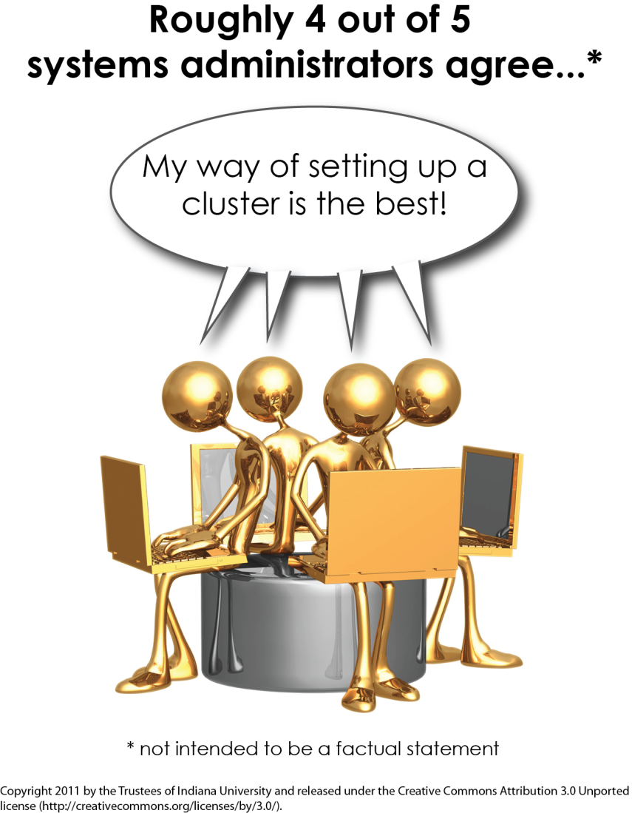
Campus Bridging - Shared Use of Facilities
XSEDE will provide tools and mediate relationships that enable making better use of aggregate CI resources and
Tools for building clusters so local clusters and XSEDE clusters are more similar and interoperable

Slide 61
XSEDE Campus Bridging Activities
Currently implementing file movement with Global Federated File System (GFFS) and distributed workflow tools in consultation with four pilot campuses
If you are interested in campus bridging, see:
  Background info and reports on campus bridging:http://pti.iu.edu/campusbridging
  XSEDE campus bridging: https://www.xsede.org/campus-bridging
Questions: send email to campusbridging@xsede.org

Slide 62
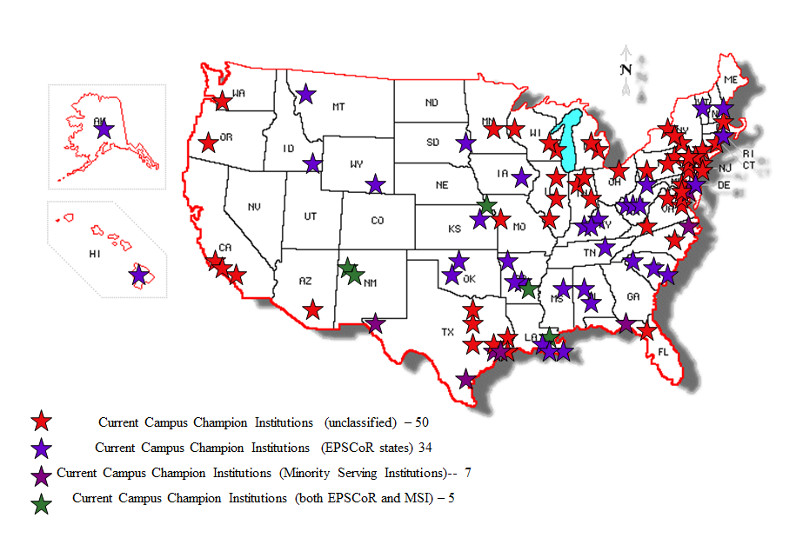
Campus Bridging Institutions

Slide 63
XSEDE Campus Bridging

Slide 64
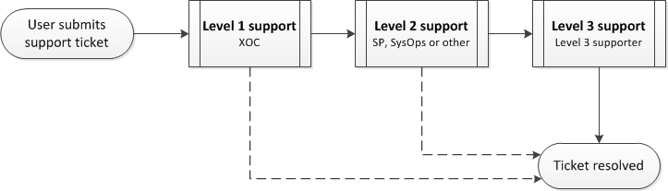
XSEDE Support Process
Level 1 support: Initial support by XSEDE Operation Center (XOC)
Level 2 support: More in-depth technical support by service providers, SysOps or other XSEDE support group
Level 3 support: highest level of support for solving the most difficult problems by subject matter expert(s)

Slide 65
Supporters
Level 1 support: XOC at NCSA staffed 7x24. Attempts to resolve and then routes tickets. Keep XOC/Mike Pingleton aware of support personnel changes
Level 2 support: SPs, SysOps, and other support groups as defined in XSEDE ticket system. Mike Pingleton coordinates support groups. Need to keep ticket system support groups up-to-date
Level 3 support: Subject matter expert supporters listed in XSEDE Systems and Services Baseline (SSB) document Section 5. Troy Baer coordinates SSB document. Need to continuously keep this up-to-date.

Slide 66
3rd Annual EU-US HPC Summer School
July 24-28 in Dublin, Ireland
Graduate students and postdocs from US and EU
Inter-disciplinary topics
Presentations by leading scientists
Hands-on introduction to HPC tools and resources
MPI, OpenMP, CUDA programming
Scientific Visualization, code performance and tuning
Big data in science and engineering

Slide 67
For Further Information
Website – www.XSEDE.org
XSEDE Project
  John Towns <jtowns@ncsa.illinois.edu>
XSEDE Architecture
  Dave Lifka <lifka@cac.cornell.edu>
  Andrew Grimshaw <grimshaw@virginia.edu>
  Ian Foster <foster@anl.gov>
Campus Bridging
  Craig Stewart <stewart@indiana.edu >
  Rich Knepper <rknepper@indiana.edu>
Education and Outreach
  Steve Gordon <sgordon@osc.edu>
  Scott Lathrop <scott@ncsa.uiuc.edu>
Operations
  Victor Hazlewood <victor@utk.edu>

Slide 68
Question & Answer

